Slide 1
Analog Signals
Definition
© 2014 John Sefcovic

Slide 2
ANALOG SIGNALS
An ANALOG signal measures a physical property and converts to an equivalent electrical voltage or current range.
Typical physical properties are:
Pressure
Flow
Weight
Temperature
Speed
Position
These physical properties are specified in ENGINEERING UNITS.

Slide 3
ANALOG SIGNALS
Common electrical signals are:
0 to 10 Volts
-10 to +10 Volts
0 to 5 Volts
1 to 5 Volts
4 to 20 milli-Amps (mA)
0 to 50 milli-Amps (mA)
The electrical voltage or current range is then converted to a digital value, with the maximum value determined by the number of bits used.
Common digital values are:
12 Bit – 4095
15 Bit – 32,767
others types 8, 13, 14, 16, or 21 Bit

Slide 4
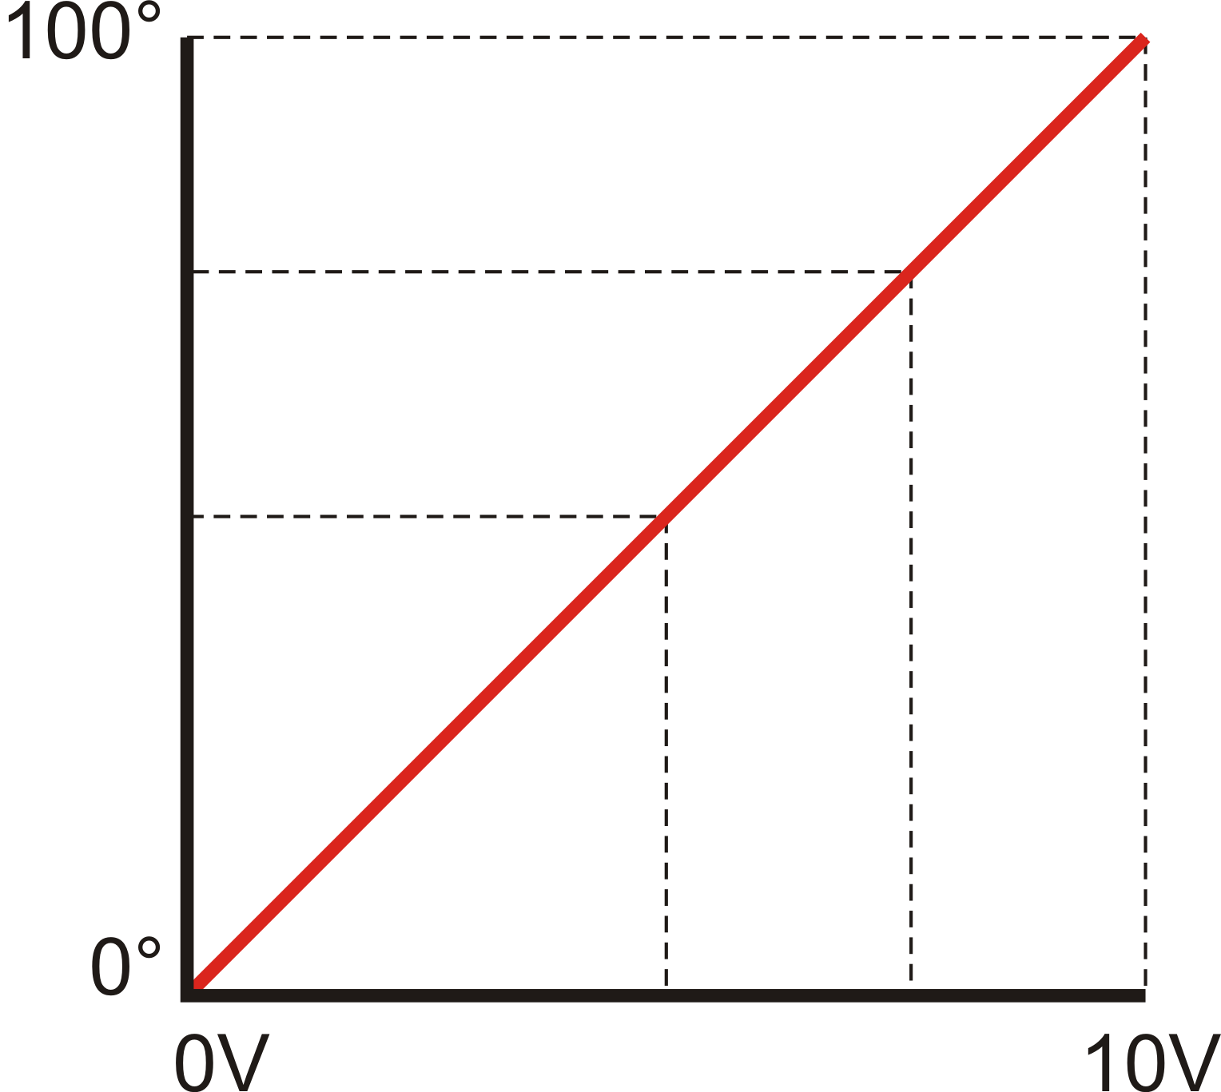
ANALOG SIGNALS
In this example a temperature of 0° to 100° is measured by a 0 to 10 Volt analog input module.
At 100° an electrical signal of 10 volts would be generated by the temperature sensor.
A temperature of 50° would produce a 5 volt signal.
A temperature of 75° would produce a 7.5 volt signal.

Slide 5
ANALOG SIGNALS
There are two types of analog signals, input or output.
An ANALOG TO DIGITAL (A/D) conversion is an Analog Input.
The electrical sensor is attached to an Analog Input module, the electrical signal is converted to an equivalent binary number value and is received by the controller.
An DIGITAL TO ANALOG (D/A) conversion is an Analog Output.
To an Analog Output module an electrical actuator is attached, a binary number value sent from the controller is converted to an equivalent electrical signal.

Slide 6
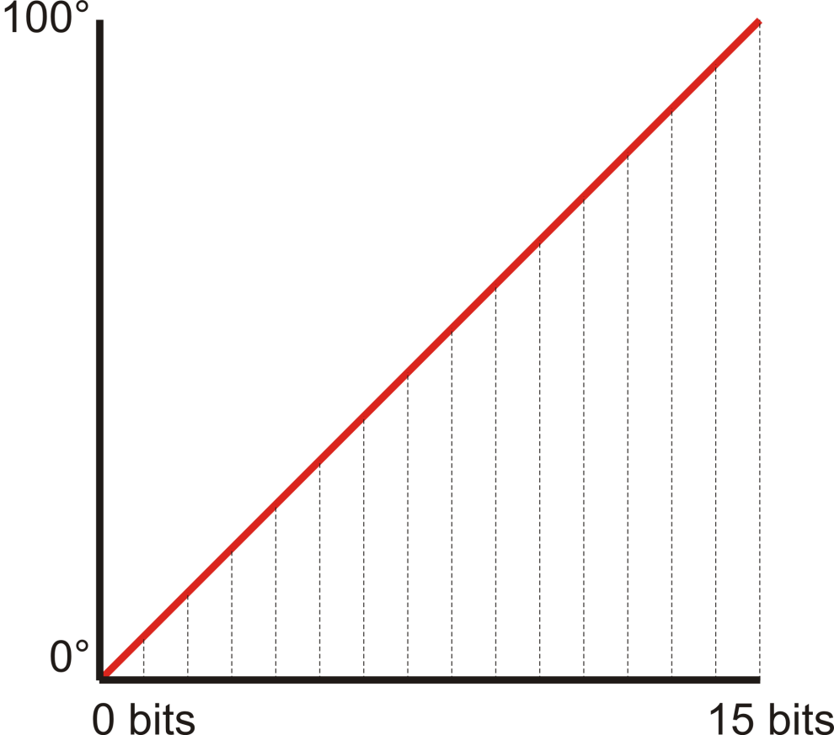
ANALOG SIGNALS
The RESOLUTION of the signal depends on the number of bits used to represent the physical property as an digital signal.
In this example, a FOUR BIT analog input would have 15 steps.
100° / 15 = 6.7°
Each change in bit value would be a change in temperature of 6.7°
= 6.7°
= 13.4°
= 20.1°

Slide 7
ANALOG SIGNALS
The number of bits determines the theoretical voltage per bit.
In a 0 to 10 Volt analog module is divided by the number of bits to voltage change per bit:
A 12 Bit analog module:
10V / 4095 = 0.0024V/bit (2.4mV)
A 15 Bit analog module:
10V / 32767 = 0.0003V/bit (0.3mV or 300uV)
The actual change per bit is determined by the sensitivity of the module’s electronics.

Slide 8
ANALOG SIGNALS
Theoretically, the temperature change for the analog input modules would be 0.024°/bit for a 12 bit input and 0.0031°/bit for a 15 bit input.
The actual change depends on multiple conditions. The sensor’s sensitivity, the actual bit resolution of the module, and the processing timing.

Slide 9
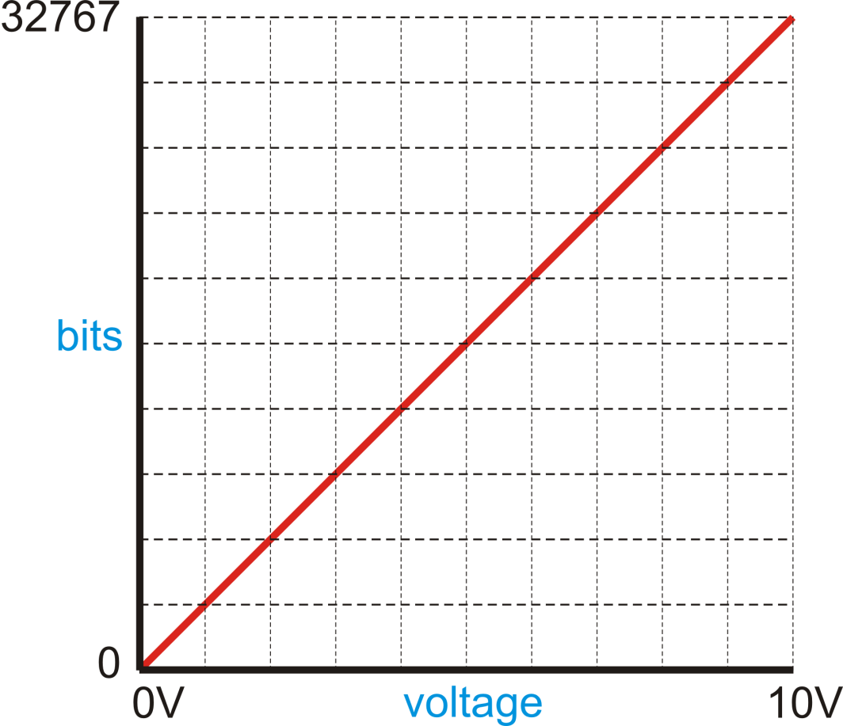
ANALOG SIGNALS
The relationship for an analog signal is the equivalency of the voltage/current range to the number of bits.
A sensor’s inputs of 5 volts would be converted to a bit value of 16,383.
A sensor’s inputs of 10 volts would be converted to a bit value of 32767.

Slide 10
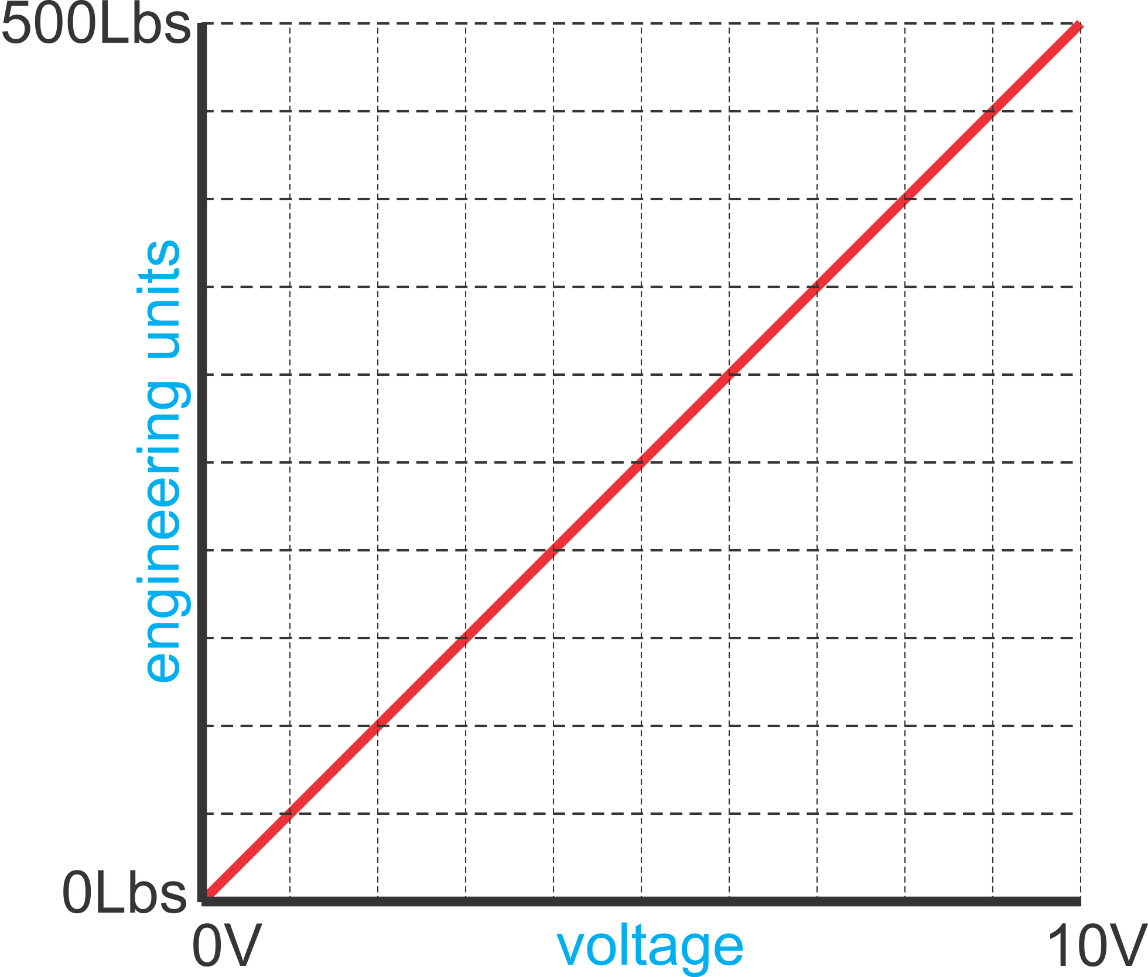
ANALOG SIGNALS
To be useful, the bits must be be SCALED to range of the physical property measured.
The SCALED range are in ENGINEERING UNITS.
In this example, the maximum value being measured is 500 lbs. is equivalent to 32,767 bits.

Slide 11
ANALOG SIGNALS
SCALING for inputs is defining a ratio of bits per unit being measured for change in voltage/current.
SCALING for outputs is defining a ratio of bits per voltage/current unit of change in the physical property being controlled.
Scaling may be done by compute instructions, instructions for scaling, or by the module wired to the devices.
The method to achieve scaling is dependent on the system used.

Slide 12
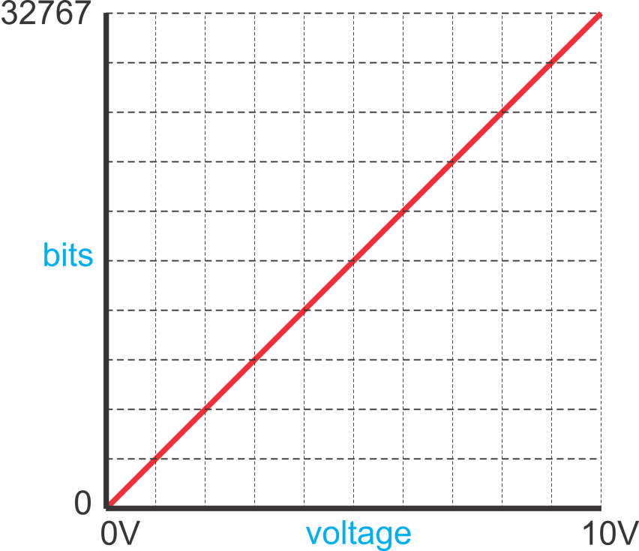
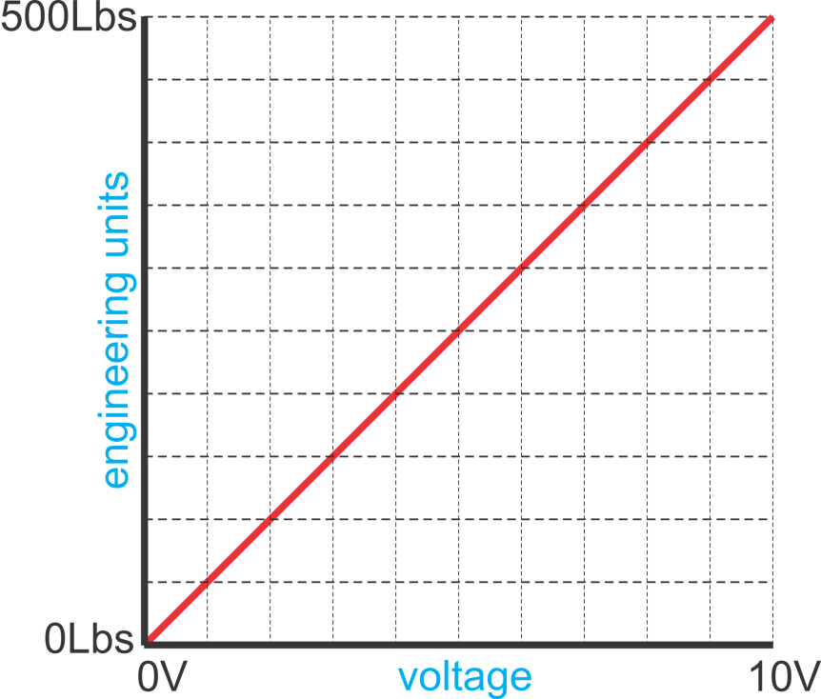
ANALOG SIGNALS
For analog inputs and outputs, scaling is defining a ratio of the engineering units, the value range being measured, and the bit values produced by the electrical signal.

Slide 13
SCALING CALCULATIONS
bit min or max: minimum or maximum bit value of the module
scaled min or max: minimum or maximum value in engineering units, i.e. 0 psi. to 500 psi
scaled value: value in engineering units to determined from bit value
bit value: binary equivalent of scaled value
ANALOG INPUT (Bit value to Scaled Value)
Scaled value = (bit value x slope) + offset
Slope = (scaled max. – scaled min.) / (bit max. – bit min.)
Offset = scaled min. – (bit min. x slope)
ANALOG OUTPUT (Scaled value to Bit value)
Bit value = (scale value x slope) + offset
Slope = (bit max. – bit min.) / (scaled max. – scaled min.)
Offset = bit min. – (scaled min. x slope)

Slide 14
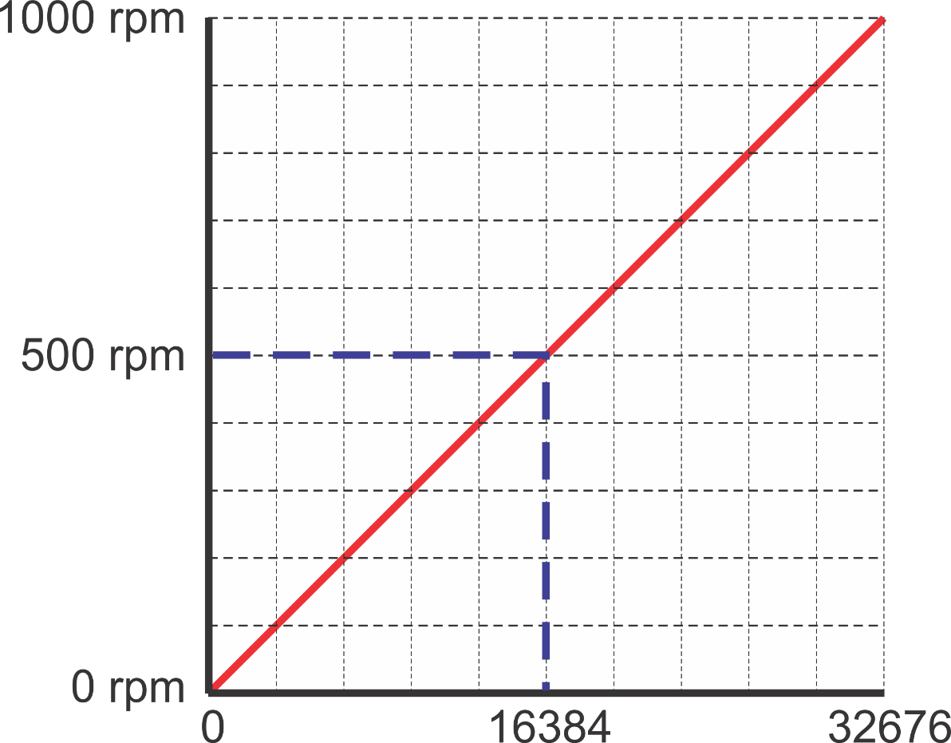
SCALING CALCULATIONS
bit min or max: minimum or maximum bit value of the module
scaled min or max: minimum or maximum value in engineering units, i.e. 0 psi. to 500 psi
scaled value: value in engineering units to determined from bit value
bit value: binary equivalent of scaled value
ANALOG INPUT EXAMPLE
Scaled Value: 0 to 1000 rpm
Bit Minimum and Maximum of Module: 0 to 32767
Bit Value from Analog Input: 16384
Slope = (1000 - 0) / (32767 - 0), Slope = 1000/32767 = 0.03051
Offset = 0 - (0 x 0.031) = 0
Scaled Value = (16384 x 0.03051) + 0 = 499.8758 rpm

Slide 15
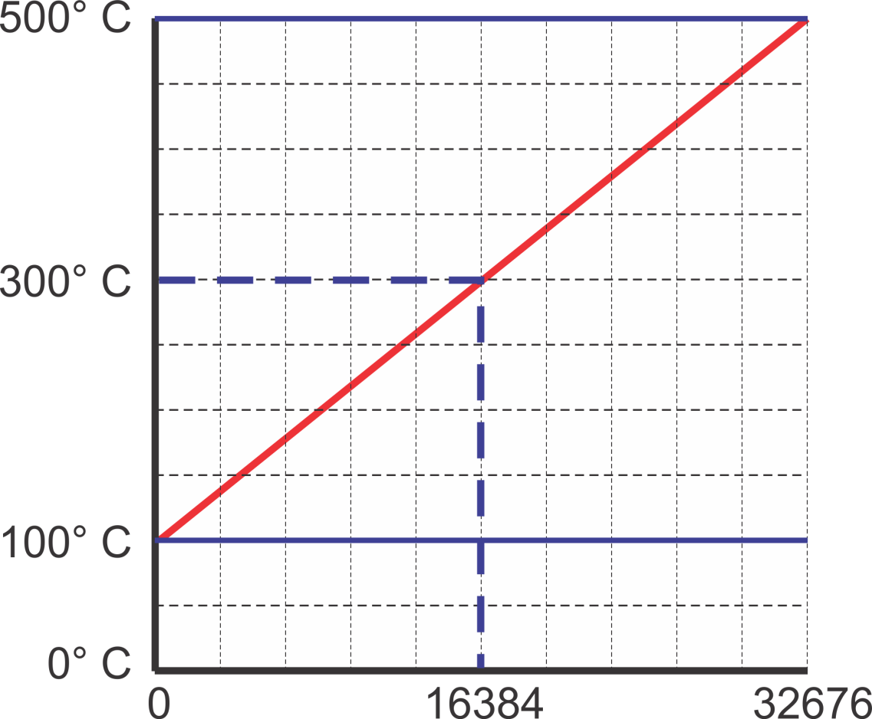
SCALING CALCULATIONS
bit min or max: minimum or maximum bit value of the module
scaled min or max: minimum or maximum value in engineering units, i.e. 0 psi. to 500 psi
scaled value: value in engineering units to determined from bit value
bit value: binary equivalent of scaled value
ANALOG INPUT EXAMPLE
Scaled Value: 100̊ C to 500̊ C
Bit Minimum and Maximum of Module: 0 to 32767
Bit Value from Analog Input: 16384
Slope = (500 - 100) / (32767 - 0), Slope = 400/32767 = 0.01220
Offset = 100 - (0 x 0.01120) = 100
Scaled Value = (16384 x 0.01220) + 100 = 199.8848 + 100 = 299.8848 ̊ C

Slide 16
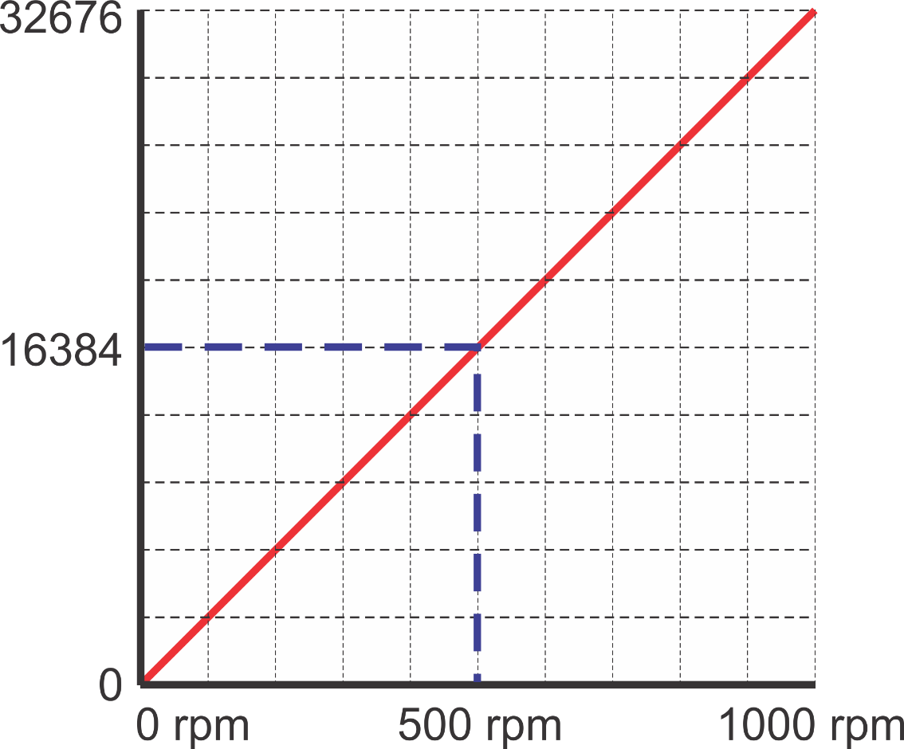
SCALING CALCULATIONS
bit min or max: minimum or maximum bit value of the module
scaled min or max: minimum or maximum value in engineering units, i.e. 0 psi. to 500 psi
scaled value: value in engineering units to determined from bit value
bit value: binary equivalent of scaled value
ANALOG OUTPUT EXAMPLE
Scaled Value: 0 to 1000 rpm
Bit Minimum and Maximum of Module: 0 to 32767
Scaled Value to Analog Output: 500 rpm
Slope = (32767 - 0) / (1000 - 0), Slope = 32767/1000 = 32.767
Offset = 0 - (0 x 0.031) = 0
Scaled Value = (500 x 32.767) + 0 = 16,383.5 [16,384 bit value]

